Slide 1
Shellcode Injection
ENPM 691

Slide 2
Agenda
Basic stack-based buffer overflow attack
Overview of stack layout
Placing the shellcode on the buffer
By-pass Address Space Layout Randomization
jmp to bss
jmp to esp

Slide 3
References
Computer Systems programmer’s perspective
Chapter 3 on Procedures
Secure Coding in C and C++
Chapter 3 on Pointer Subterfuge
Hacking – The art of exploitation
Chapter 3 on Buffer Overflows
Chapter 5 on Shellcode
http://www.shell-storm.org/shellcode/
Archive of shellcode
http://www.exploit-db.com/wp-content/themes/exploit/docs/28475.pdf

Slide 4
Goal/Context
Goal: Attacker wants to gain root/admin permission
Context: Program runs with the root permission
In Linux world, the suid bit is on
If such a program is vulnerable, then the attacker is able to become a root/admin

Slide 5
An Example suid binary
ls -al /usr/bin/passwd
-rwsr-xr-x 1 root root 53128 May 16 19:38 /usr/bin/passwd
This command will find all suid binary:
find /usr/bin -perm -4555

Slide 6
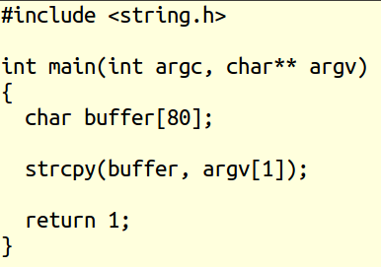
Victim Program
Assume this program runs with the root permission
What if argv[1] is more than 80 char bytes?
How to put shellcode into argv[1]?

Slide 7
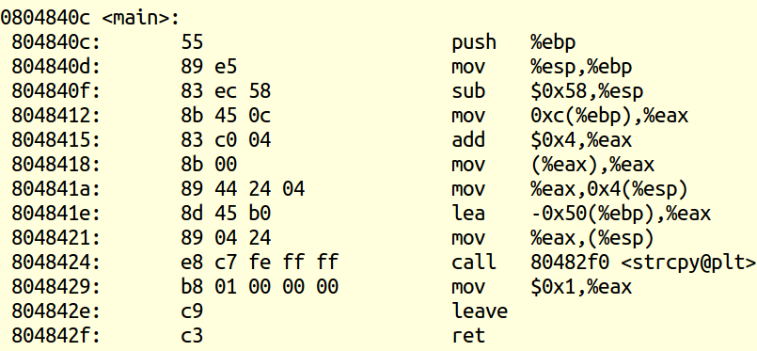
Victim’s program assembly

Slide 8
Victim’s program stack before strcpy
High Memory
RET add to libc
EBP
Old EBP
Buffer (80 bytes)
EBP-80
Ptr to argv[1]
Ptr to buffer
ESP
Low Memory

Slide 9
A strategy for exploiting the victim
We need to fill 80 bytes for buffer
4 bytes for EBP
4 bytes for return address
Our input argv[1] should be at least 88 bytes

Slide 10
Constructing argv[1]
24 bytes for shellcode
60 bytes of NOP (no action instruction) sled
4 bytes for return address of &buffer
In total, 88 bytes filled!
Challenge: the address of buffer?

Slide 11
Address space layout randomization (ASLR)
In modern versions, address space is randomized
Address of stack differ varies between runs
Try printing the address of buffer two runs
For this exploit, we need to switch off the ASLR
If you have a root permission run this:
echo 0 > /proc/sys/kernel/randomize_va_space

Slide 12
Victim’s program stack after strcpy
High Memory
Pointer to buffer
NOP (4bytes)
EBP
Return to libc address is overridden
After main, control will execute our shellcode
NOP (56 bytes)
Shell code (24 bytes)
EBP-80
Ptr to argv[1]
Ptr to buffer
ESP
Low Memory

Slide 13
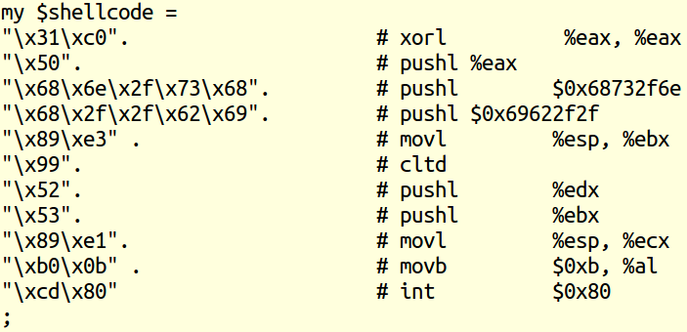
Constructing argv[1] using a Perl script (step 1: copy and paste shellcode)

Slide 14
Step 2: Get address of buffer variable

Slide 15

Step 3: NOP sled of 60 bytes

Slide 16

Step 4: Construct argv string

Slide 17
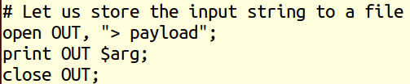
Step 5: Store argv to a file

Slide 18
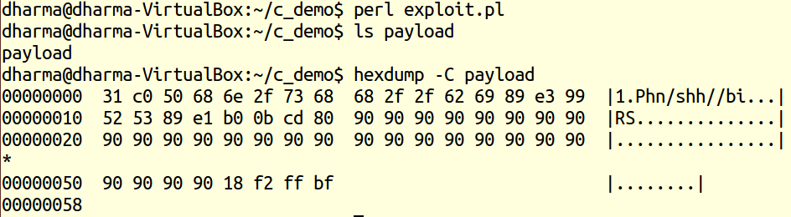
Step 6: Run the Perl script
We constructed 88 bytes to exploit the victim!
88 bytes are stored in the payload file

Slide 19
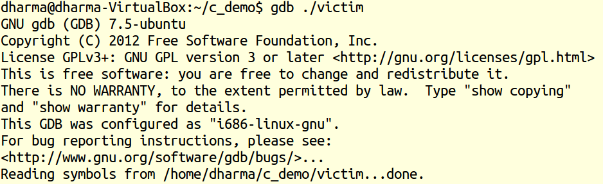
Running the victim in gdb

Slide 20
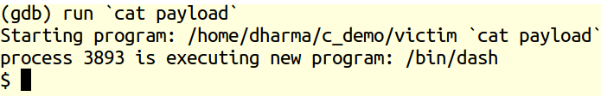

Running the victim in gdb
We got a shell
Back to gdb

Slide 21
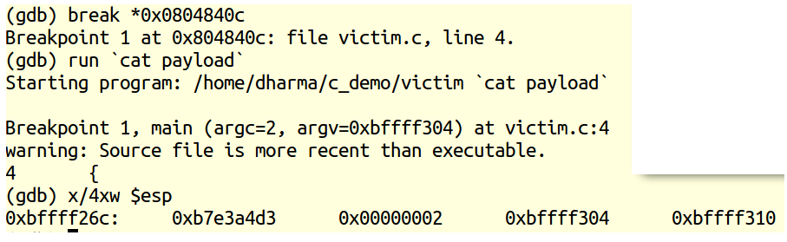
Why it worked?
Before main runs, the esp points to the return to libc (0xb7e3a4d3)

Slide 22
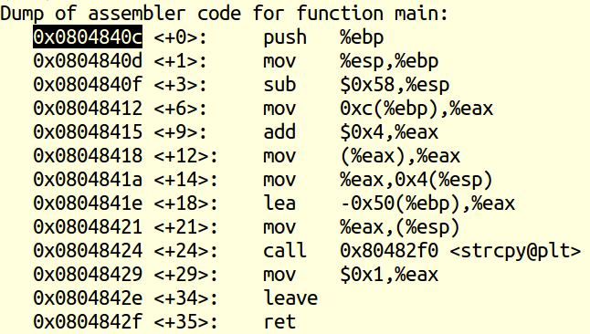
Why it worked? …
Break *0x08048424 -> Right before calling the strcpy

Slide 23
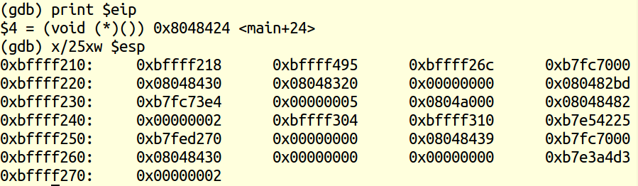
Why it worked? …
Just before the call to the strcpy instruction
Pointer to buffer
Pointer to argv[1]
80 bytes for buffer (20 X 4 words)
Old ebp (or) libc ebp
Return address to libc

Slide 24
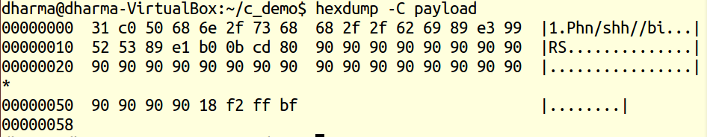
What is in our argv[1]?

Slide 25
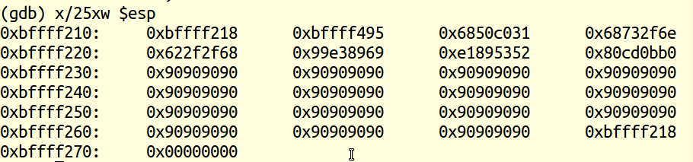
Why it worked? …
Just after the call to the strcpy instruction
24 bytes for shellcode (see payload)
Old ebp (or) libc ebp
Return address to our buffer!

Slide 26
Agenda
Basic stack-based buffer overflow attack
Overview of stack layout
Placing the shellcode on the buffer
By-pass Address Space Layout Randomization
jmp to bss
jmp to esp

Slide 27
Handling ASLR
Only stack addresses are randomized
Other memory regions are NOT randomized:
Text (read only program code)
BSS (uninitialized global and static variables)
Put shellcode in non-randomized memory!

Slide 28
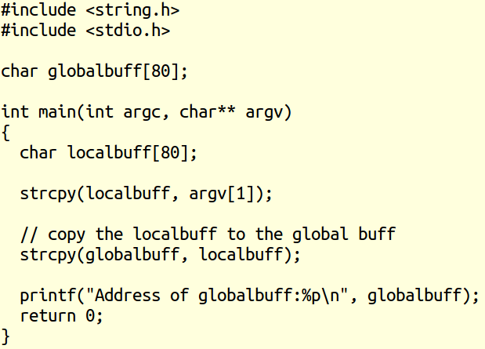
Victim code
globalbuff is stored in BSS
globalbuff address will NOT change for each run

Slide 29
How to hack the victim?
Step 1: Figure out the address of globalbuff
Use gdb, for example
Step 2:
Fill 24 bytes of shellcode to localbuff
Fill 60 bytes of NOP
Fill the address of the globalbuff (instead of localbuff address we used in the past exploits)
Step 3: Run the victim
The Perl script shown next does the job!

Slide 30
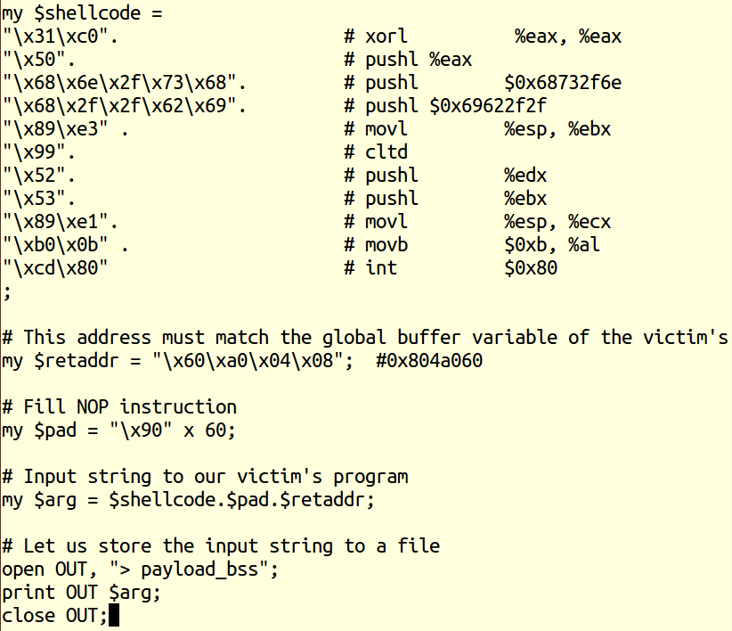
Perl script for hacking the victim
Generates input for argv[1]

Slide 31
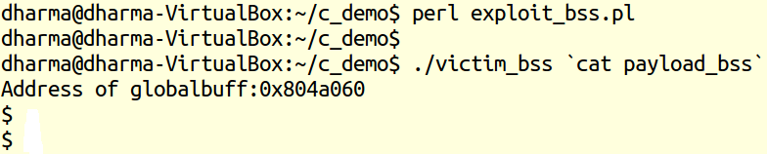
Running the victim
We got a shell
ASLR can be by-passed if we put shellcode in non-randomized memory regions

Slide 32
Agenda
Basic stack-based buffer overflow attack
Overview of stack layout
Placing the shellcode on the buffer
By-pass Address Space Layout Randomization
jmp to bss
jmp to esp

Slide 33
Another strategy for exploiting
No need to put shellcode into the buffer
Instead fill the buffer and EBP with NOP
Put the address of “jmp *%esp “ into return
Put shellcode into the old esp location
Victim’s function control will jump there
Shellcode gets executed!

Slide 34

Recall our victim
Finding the address of jmp *%esp is not easy

Slide 35
Victim’s program stack before strcpy
High Memory
RET add to libc
EBP
Old EBP
Buffer (80 bytes)
EBP-80
Ptr to argv[1]
Ptr to buffer
ESP
Low Memory

Slide 36
Strategy for Constructing argv[1]
80 bytes of NOP
4 bytes of NOP for EBP
4 bytes of new return address to jmpesp
shellcode

Slide 37
Victim’s program stack after strcpy
shellcode
High Memory
Pointer to jmpesp
EBP
NOP (4bytes)
Return to libc address is overridden
Now points to jmpesp
After main, control will flow to jmpesp
NOP (80 bytes)
EBP-80
Ptr to argv[1]
Ptr to buffer
ESP
Low Memory

Slide 38
Victim’s program stack after main
ESP
shellcode
High Memory
EIP = address of jmpesp function
Low Memory

Slide 39
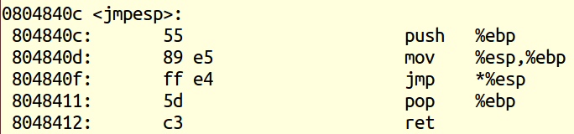
Jmpesp disassembled code
804840f is the point of interest for us

Slide 40
Constructing argv[1] using a Perl script (step 1: copy and paste shellcode)

Slide 41

Step 2: Fill NOPs for 84 bytes
80 bytes for our buffer
4 bytes for EBP

Slide 42
Step 3: Fill ret address to jmpesp

Slide 43

Step 4: Prepare argv string
shellcode above the return address in stack

Slide 44
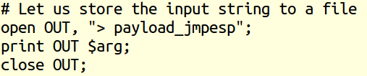
Step 5: Write to argv string to a file

Slide 45
Step 6: Run the victim
We got a shell

Slide 46
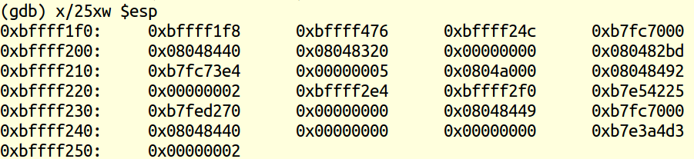
Why it worked? …
Just before the call to the strcpy instruction
Pointer to buffer
Pointer to argv[1]
80 bytes for buffer (20 X 4 words)
Old ebp (or) libc ebp
Return address to libc

Slide 47
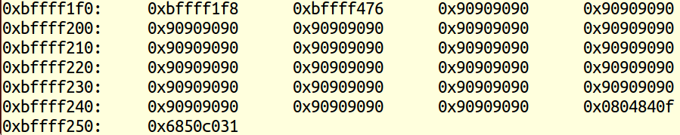
Why it worked? …
Just after the call to the strcpy instruction
Old ebp (or) libc ebp
Return address to jmpesp

Slide 48
Why it worked? …
Just before the victim’s ret instruction
24 byte shellcode
address of jmpesp

Slide 49
Why it worked? …
Just after the victim’s ret instruction
24 byte shellcode
shellcode got executed because jmp *%esp will execute above instructions!!

Slide 50
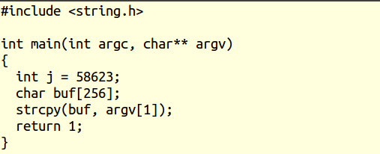
What if jmp *%esp is in our binary?
The machine code for jmp *%esp is: ff e4
In little endian: e4 ff -> 58623 (dec)

Slide 51
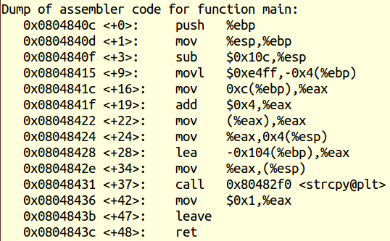

Analysis of disassembly of the victim
Key idea: Overwrite the EIP by 0x08048418

Slide 52
Constructing argv[1] using a Perl script (step 1: copy and paste shellcode)

Slide 53

Step 2: Fill NOPs for 264 bytes
256 bytes for our buffer
4 bytes for local variable
4 bytes for EBP

Slide 54
Step 3: Fill ret address to jmpesp

Slide 55

Step 4: Prepare argv string
shellcode above the return address in stack

Slide 56

Step 5: Write to argv string to a file

Slide 57
Step 6: Run the victim
We got a shell

Slide 58
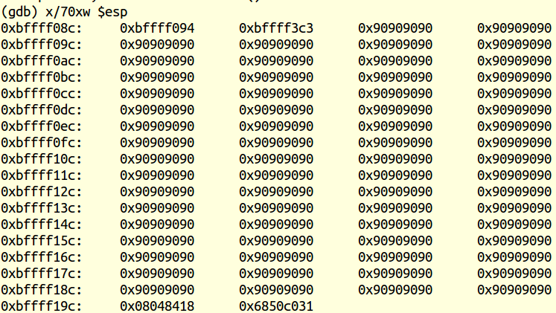

Why it worked?
The stack layout right after the call to strcpy instruction
Our shellcode

Slide 59

Why it worked?
The stack layout before the ret instruction
24 byte shellcode
address of jmpesp

Slide 60
Summary …
Try these types of analysis at home
Make sure the following for gcc:
-mpreferred-stack-boundary=2
-zexecstack
-fno-stack-protector

